Slide 1
citl.ucsc.edu | citl@ucsc.edu | McHenry Library 1330A
WDYT Information Session & Workshop
Stevenson Conference Center
Nov. 7, 2018
Jody Greene
Associate Vice Provost for Teaching and Learning
Director of CITL
Professor of Literature
Executive Sponsor for WDYT Project
Kimberly Adilia Helmer
Chair of COT
Teaching Professor of Writing
Nic Brummell
Member of COT
Professor of Applied Mathematics
Rebecca Peet
SETs Service Manager
Faculty Instructional Technology Center
Learning Technologies
Information Technology Services, UCSC

Slide 2
Welcome & Agenda
Revisioning a Teaching Culture: COT and SETs
WDYT: A New Platform, A New Approach
WDYT: An ITS Service Provider Perspective
Crafting Custom Questions: During & End-of-Quarter

Slide 3
Revisioning a Teaching Culture: Committee on Teaching & SETs
COT SET Workflow:
WDYT Implementation (2018)
Study Informed SET Changes
COT Charged with SET Policy
SETs @ UCSC: Chair Survey (2018-19)
WDYT Platform Selected & Contract Signed (2015-17)
COT SET Study:
Winter 2019
SETs @ UCSC: Instructor Survey
(2018-19)

Slide 4
citl.ucsc.edu | citl@ucsc.edu | McHenry Library 1330A
What Do You Think?
A New Platform and a New Approach
Jody Greene
Associate Vice Provost for Teaching and Learning
Director of CITL
Professor of Literature
Executive Sponsor for WDYT Project

Slide 5
What’s New in WDYT?
Name change: from “evals” to “SETs”
All end of term instructor surveys are now online
Instructors can see response rates but not individual respondents
TA surveys are online and TAs can access their reports online and can export their own reports
Instructor customization is possible with this system (although not in F18)
Gradual move to questions that are designed to elicit better, less biased, more “formative” information
Some improvements for students as well—fewer emails, better questions, more targeted feedback opportunities

Slide 6
The Name Change
From “Course Evaluations” to “Student Experience of Teaching Surveys [SETs]”
WHY?

Slide 7
The Instructor Experience
Your courses appear automatically in student portals as before
This includes graduate seminars
You can access WDYT through Canvas, WDYT, and, after the fact, the DivData portal

Slide 8
Response Rates
You can see the percentage of students who have responded anytime after the beginning of 9th week
You cannot see whether individuals have responded
Why is this important?
To help you increase response rates and in case you use Extra Credit

Slide 9
The TA Experience
TA surveys are now online
Graduate students will be able to immediately electronically access their own past teaching record without going through department staff.
Grads will need to export this record when they leave the campus, in order to be able to represent their UCSC teaching in future.

Slide 10
Customization
You can do mid-quarter surveys OR you can add questions at the end of term.
Mid quarter surveys are known:
— to help people develop their teaching
— to get students to reflect on their learning
— to produce better student responses at the end of term
Anything you customize is private, meaning only you can see the responses

Slide 11
Why No Customization in Fall 2018?
To give ITS and department staff time to come up to speed
and
To give COT time to get a really simple user friendly guide to writing good questions

Slide 12
Gradual shift in how departmental survey questions are asked & scaled
Declarative statements that represent only the individual student’s experience
Scale (5 possible responses):
Can’t evaluate | Disagree | Somewhat disagree | Somewhat agree | Agree
Emphasis on writing questions that focus on student learning rather than faculty’s teaching style or satisfaction with the course
Effort to reduce the possibility for implicit bias
Examples:
The lectures were clear helped me clearly understand key concepts
The instructor’s comments on students’ my written work were helpful helped me improve my writing
The Teaching Assistant was effective in supporting my learning in the course as a whole.
The instructor was available and helpful outside of class time for scheduled office hours or by appointment

Slide 13
Advice for Increasing Your Return Rates and Limiting Bias
Talk to your students about how SETs are used (both to improve our teaching and in every personnel action)
Ask them to give you constructive and specific feedback that you can use to improve your teaching
Incorporate the feedback they give you at mid quarter to make changes to the course, signaling that you take their input seriously
Inform them that bias is a common problem with SETs and ask them to be thoughtful and respectful – this isn’t YELP.
Use class time to allow students to complete SETs

Slide 14
citl.ucsc.edu | citl@ucsc.edu | McHenry Library 1330A
What Do You Think? An ITS Service Provider Perspective
Rebecca Peet
SETs Service Manager
Faculty Instructional Technology Center
Learning Technologies
Information Technology Services, UCSC

Slide 15
ITS Service Management
Service Management -
Allows ITS to organize the way we manage and present technology
Provides a common language to talk about what we do
Defined Roles, in particular -
Service Manager
Service Executive Sponsor
Notes:
ITS uses something called a service management a framework to manage all of the various layers and types of technologies that we provide.

Slide 16
Role - Service Manager
Responsible for overseeing all technological aspects of a service
Integration with other infrastructure services
Training and Support
Continuous improvement
Service Manager for SETs - Rebecca Peet

Slide 17
Role - Service Executive Sponsor
Provides direction for the service and executive acceptance of the service.
Jody Greene - is the Executive Sponsor for SETs and is responsible for the policy and pedagogical practice questions related to the service.

Slide 18
The SETs service includes
Login with your cruzid and gold password at sets.ucsc.edu
Direct access to WDYT from all Canvas course sites
Training, support and all tiers of troubleshooting
Data integration with myucsc

Slide 19
Benefits for Staff
Department staff workload is significantly decreased
Courses are uploaded from MyUCSC with their session and default survey form attached

Slide 20
Benefits for Instructors
Login to your dashboard to access reports
See real time response rates
Send your own reminders to your students
W19 - Customization options
Send private mid-quarter surveys to your students
Add course specific questions to the standard end-of-term surveys, results of which are private to the instructor

Slide 21
Benefits - Reports
Access - Instructors and TAs will be able to login to WDYT the day after grades are due and see their reports.
Consistency - The same summary and per-respondent reports that are available in WDYT as a pdf will be exported as a pdf and loaded into DivData

Slide 22
WDYT - Department Staff Role
Confirm courses are loaded and setup properly
Add department specific questions to a survey
Setup the TA survey
Check response rates and track progress
Download standard end-of-term reports

Slide 23
WDYT - The Student Experience
Student receives one announcement
Expresses the value of student feedback
Provides a list of surveys to complete
Provides instructions for completing the form
Student receives one reminder every other day until their surveys are completed or the survey session closes

Slide 24
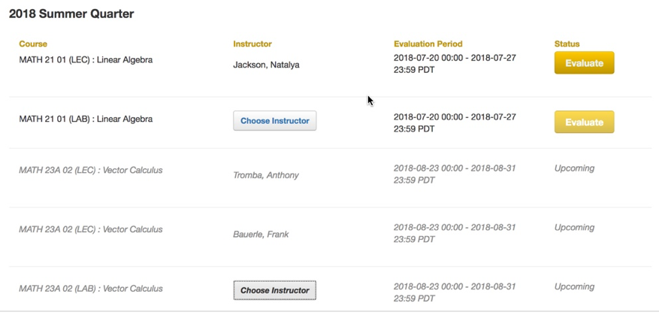
The Student Dashboard
Body Text

Slide 25
Student Options in the Survey
Move forward and backward through pages of the survey
Decline the survey
Save the survey and continue it later

Slide 26
WDYT - TA Role
TAs are instructors of “Affiliated Courses”
Can login
See Response Rates
Send messages to students
See reports the day after grades are due
Download reports

Slide 27
WDYT - Instructor Role
Can login
See Response Rates
Send messages to students
See reports the day after grades are due
Download reports
W19 - Customization
End of term questions
Mid-quarter surveys

Slide 28
Gateway page - sets.ucsc.edu
The logo is a live login link
Notes:
Struggling with this slide.

Slide 29
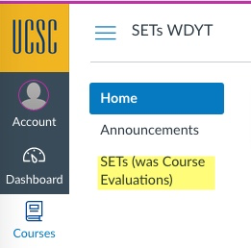
Single sign-on from Canvas
Click the link in any site that says “SETS (was course evaluations)”
Click this link

Slide 30
Click the WDYT launch button
After you click the “SETs” link you will see the link to WDYT. Click it.

Slide 31
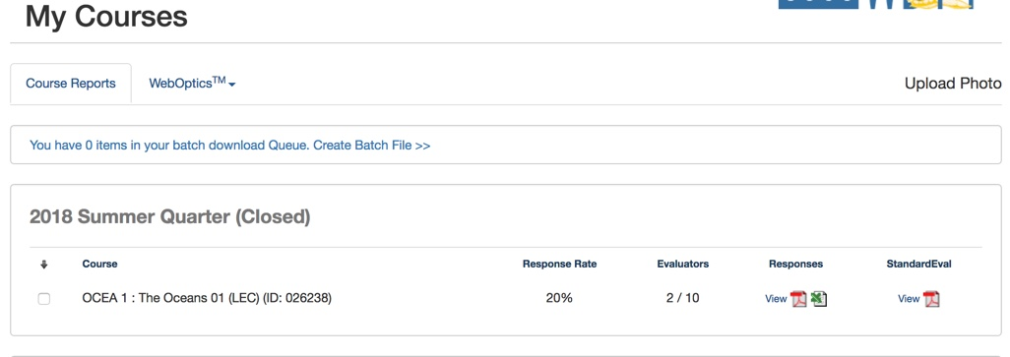
Land at your WDYT dashboard

Slide 32
Dashboard - no prior terms
The typical dashboard will look like Jody’s-

Slide 33
Dashboard - Upcoming surveys

Slide 34
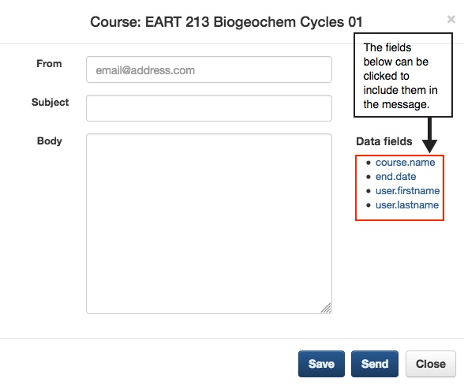
Send a Reminder

Slide 35
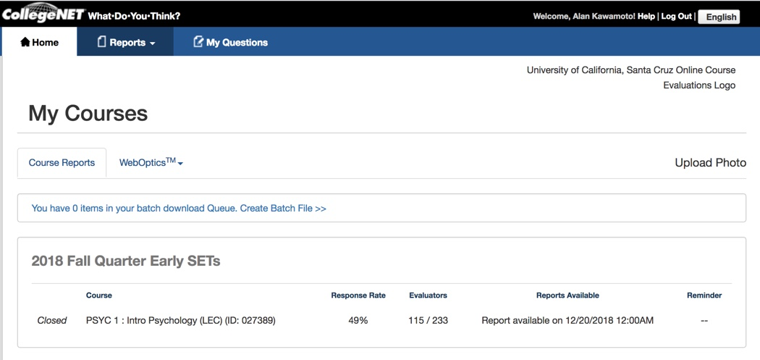
Dashboard - Response Rates

Slide 36
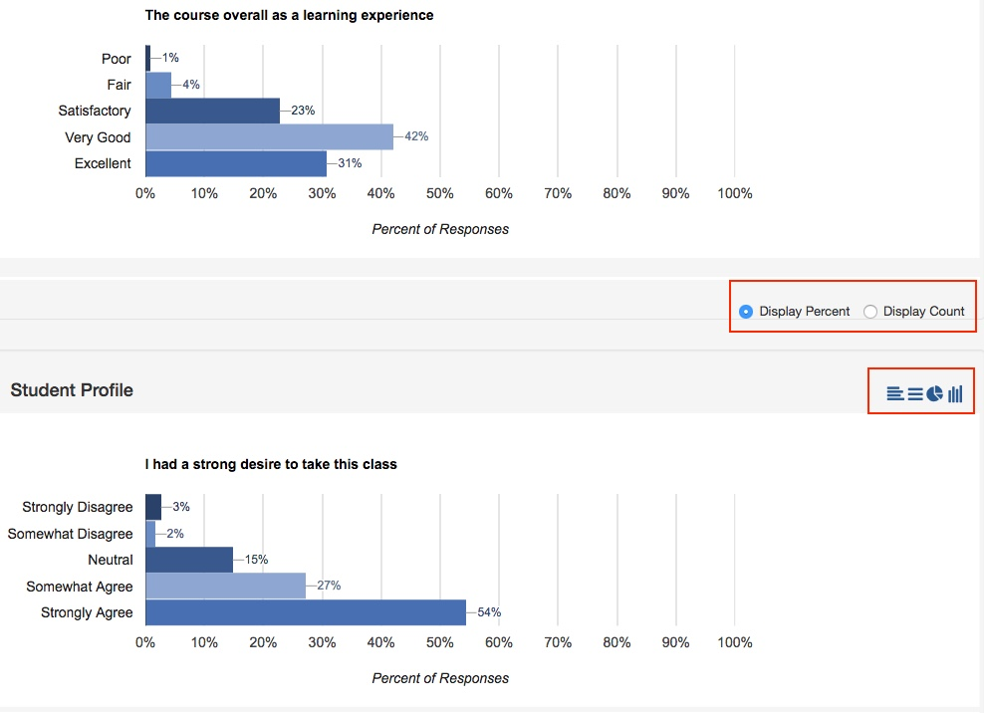
Reports - Viewing

Slide 37
Reports - Downloading

Slide 38
Got a question? Need support?
Check with your department manager or staff who works with WDYT
Send an email to sets@ucsc.edu to generate a help request in ITR
Call 9-5506 - The Faculty Instructional Technology Center (FITC) help line
Drop by FITC - 1330 McHenry Libray

Slide 39
citl.ucsc.edu | citl@ucsc.edu | McHenry Library 1330A
Crafting Custom Questions: During & End-of-Quarter
Kimberly Adilia Helmer
Chair of COT
Teaching Professor of Writing
Nic Brummell
Member of COT
Professor of Applied Mathematics

Slide 40
Why Write Custom Questions?
Reflective opportunity for teachers and learners
Midterm questions, electronic or otherwise, help improve teaching-learning in progress; prime Ss for end-of-quarter SETs
End-of-term questions provide pointed feedback for future course modification
Confidential: Instructor driven

Slide 41
Metacognition, Self-Efficacy, & Reflection
Metacognition: “Thinking about thinking” that is, the process of checking understanding and choosing appropriate strategies for improving learning.
Leads to better learning & transfer
Focuses on active learning
Promotes self-efficacy: Believing in one’s capacity to use effective metacognitive strategies

Slide 42
Metacognition, Self-Efficacy, & Reflection
Self-Efficacy: Reflects beliefs about one’s capabilities to complete
a specific task successfully, that is, “self-perceptions of competence”
Leads to greater student effort, tenacity, & achievement
Developed through:
Positive feedback & encouragement
Metacognitive strategy development

Slide 43
Writing Questions
Questions should:
Focus on learning
Focus on the student NOT the teacher (to avoid bias & comments on grades)
Be precise & simple (no jargon, i.e., avoid: “outcomes,” “metacognition,” but not too colloquial)
Connect to specific skills & knowledge
Encourage reflection

Slide 44
Writing Questions: Open-Ended
Returns more information, but time consuming to read & analyze
Appropriate for deeper reflection; a tool for developing metacognition

Slide 45
Metacognitive Examples:
A. What learning experiences or tools help you
learn how to apply, solve, or explain X?
B. What strategies have you used to learn how
to apply, solve, or explain X?
C. How did your writing change after
group-writing conferences?
D. How did your problem-solving skills change
after you have done X?
Writing Questions: Open-Ended

Slide 46
Writing Questions: Scaled (1-5) or Open
To measure student learning in terms of their Self-Efficacy in relation to specific tasks in the near future:
A. How confident do you feel about doing well on the upcoming midterm?
1-Not at all confident 2-A little confident
4-Somewhat confident 4-Confident 5-Very confident
B. Please explain how you may use X (knowledge, skill, strategy) in your next (Writing, Physics, Math, etc.) course.

Slide 47
Writing Questions: Scaled (1-5)
To evaluate specific learning tools or activities’ impact on learning of specific skills/topics:
A. How useful in YOUR learning of X were outside study groups?
1-Can’t evaluate 2-Not useful 3-Somewhat useful 4-Useful 5-Very useful
B. How helpful for YOUR learning of X were iClickers?
1-Can’t evaluate 2-Not helpful 3-Somewhat helpful 4-Helpful 5-Very helpful

Slide 48
citl.ucsc.edu | citl@ucsc.edu | McHenry Library 1330A
Customization & WDYT: Steps

Slide 49
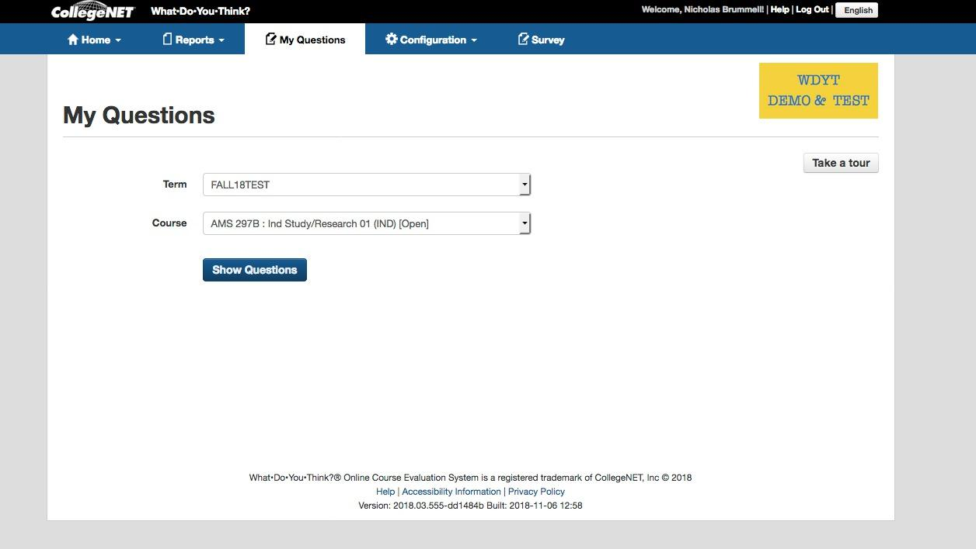
Step 1: Get into questions for a course
Step 1(a) Click on “My Questions” in your login dashboard
Step 1(b):
Choose term and course
Click on “Show Questions”

Slide 50
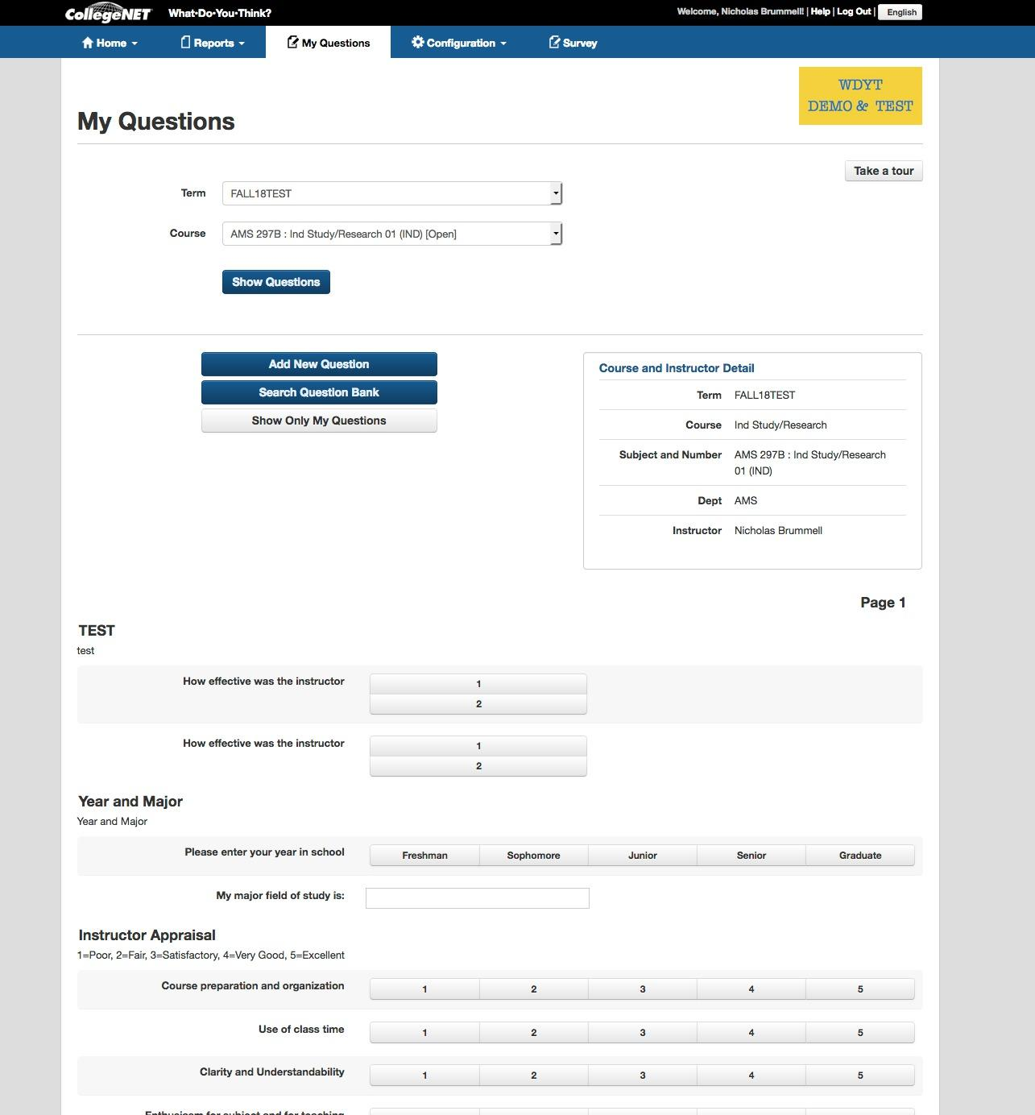
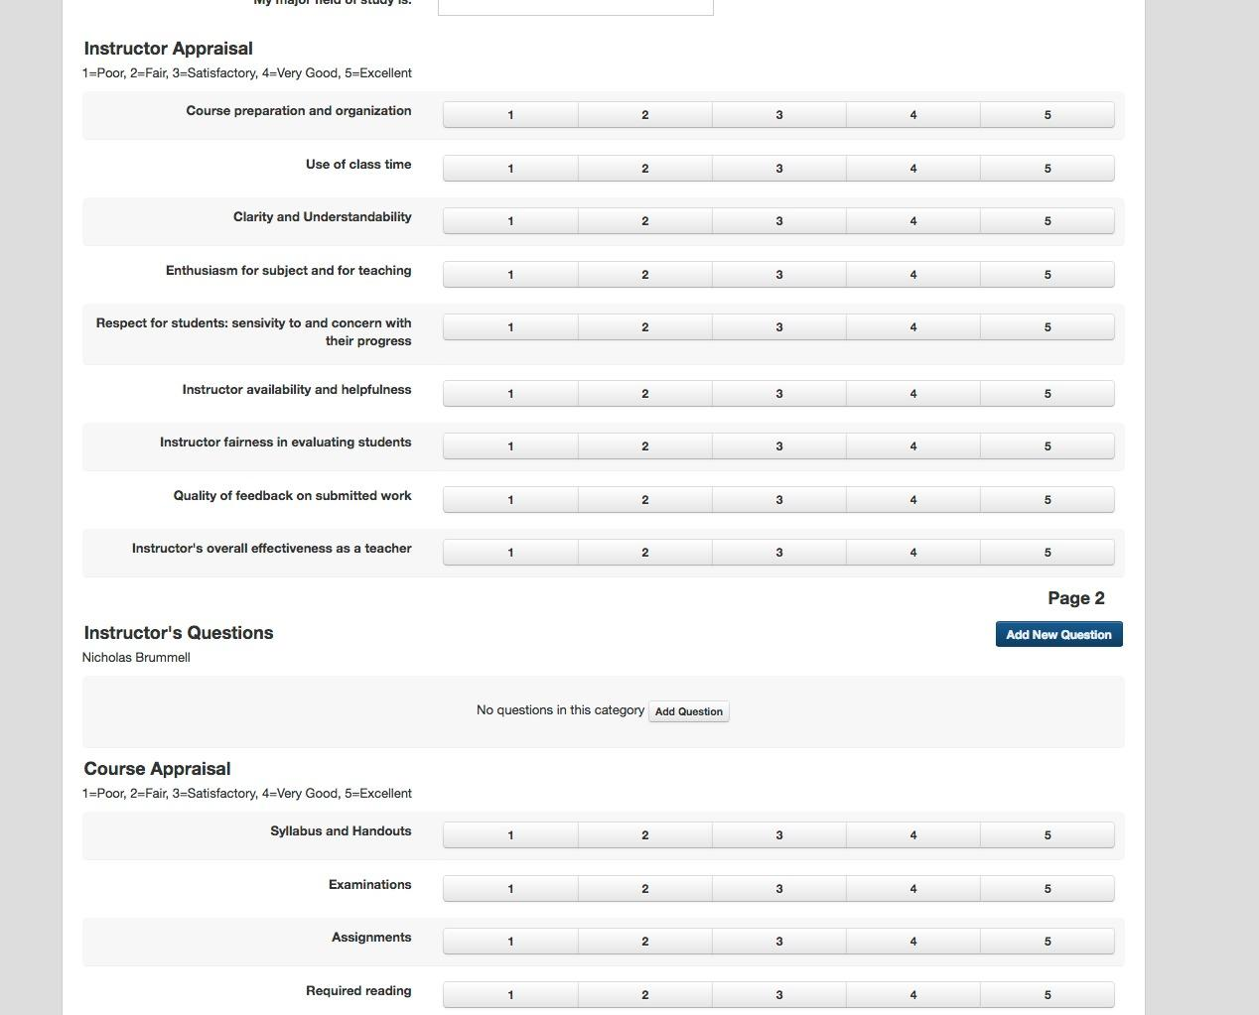
Step 2: You will see questions for that course ...

Slide 51
Step 2: … and can add questions for that course
Click on “Add New Question”

Slide 52
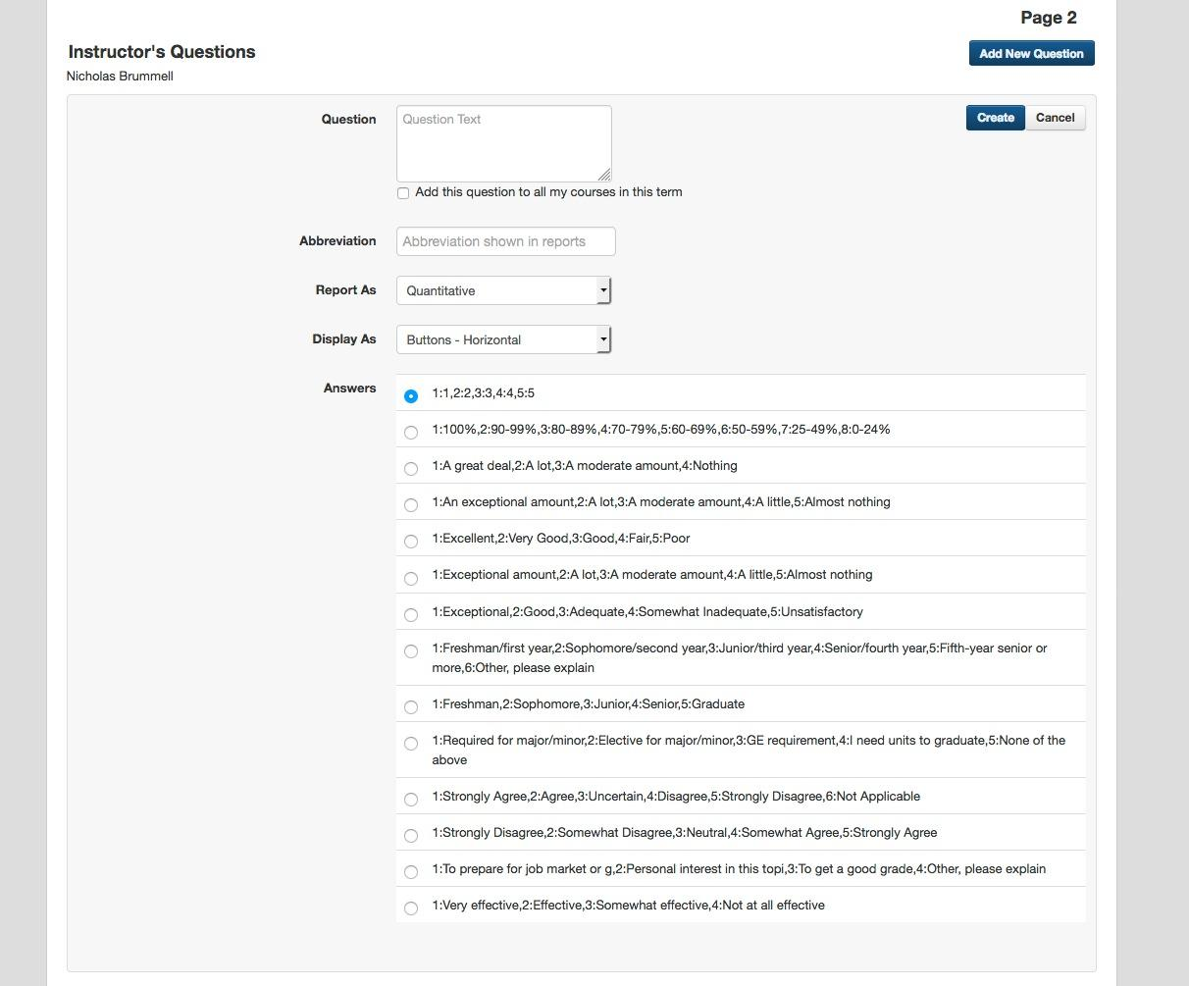
Step 3: Add quantitative question (default screen)
DEFAULT:

Slide 53
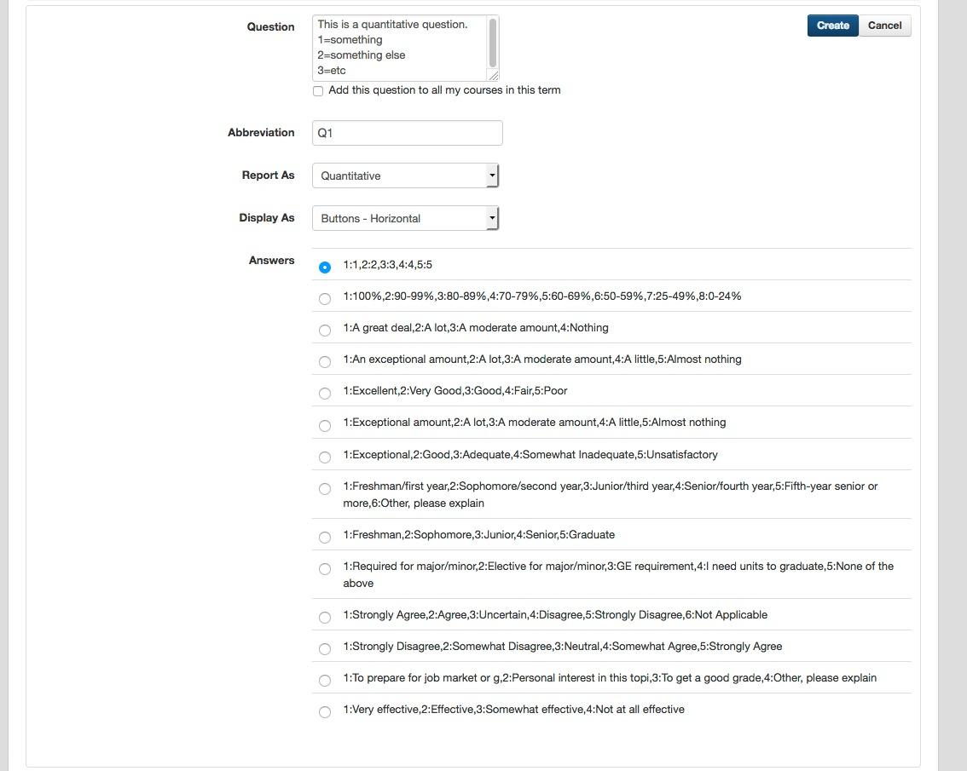
Step 3: Example of adding quantitative question
Type in a question
Set other options
NOTE!
Once set, for a quantitative question, is set for ALL subsequent questions! (a “feature”!).

Slide 54
Step 3: Example of adding a quantitative question
Hit create!

Slide 55
Step 3: Result of adding a quantitative question
RESULT:

Slide 56
Step 4: Add a written question instead
OR, switch from default “Quantitative” to “written”:
O
Select from drop down

Slide 57
Step 4: Example of creating a written question
Type in a question
Set other options

Slide 58
Step 4: Example of creating a written question
Hit create!

Slide 59
Step 4: Result of creating a written question
RESULT:

Slide 60
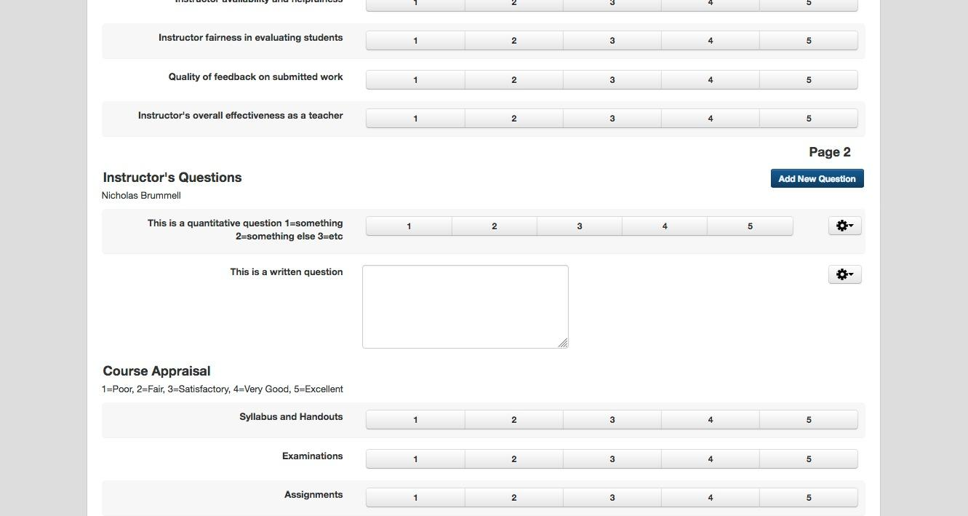
FINAL: Results of adding questions

Slide 61
Step 5: Editing
Edit, change order, delete questions

Slide 62
Workshop: Demo site
its.ucsc.edu/WYDT-demo

